Slide 1




Next Gen Employability Program
Full Stack Web Development with AI Tools
Team Details- NG_CP_Team_2260
Name: Abhinav Kathait
Name: Abhay Sharma
Name: Aryan Rawat
Name: Drami Sharma
Name: Dravya Jain
College: Inderprastha Engineering College, Ghaziabad

Slide 2

The content is curated from online/offline resources and used for educational purpose only.
Notes:
Speaker would be briefing the students that this content has been prepared for the educational purpose only and is referred from multiple sites which are cited in the last.​​
---------------------------------------------------​​
A disclaimer is a statement or notice that is intended to clarify, limit, or provide information about the scope, limitations, or potential risks associated with certain actions, information, products, services, or content. ​​
​​
​

Slide 3

Project Title
Scan and Dine
Notes:
In this slide speaker will be introducing the program and its outcomes. The speaker will introduce himself in brief

Slide 4

Table of Contents
Introduction
Objective
Problem Statement & Motivation
Solution Approach
Technology Used
System Architecture / Flowchart
Key Features & Benefits
Conclusion & Future Work
References
Notes:
This slide, The speaker will talk about the content that we will be covering in this session as follows:
Introduction
Importance of UI/UX in industry
History and Definitions of UI and UX
Key Differences between UI/UX
Use Cases
Significance in Web Development
Use Cases
Visual Design Principles
Design process
Color theory and psychology
Typography and readability
Layout and Spacing
Responsive design basics
Usability and Accessibility
Usability Aspects
Web Content Accessibility Guidelines (WCAG)
Inclusive design practices
Consistency
User Experience
User-Centered Design
User research methods
Interactive Elements and Feedback
Mini Case Study
Discussing a popular UI/UX design
Hands-On
Introduction to Figma for UI/UX design

Slide 5
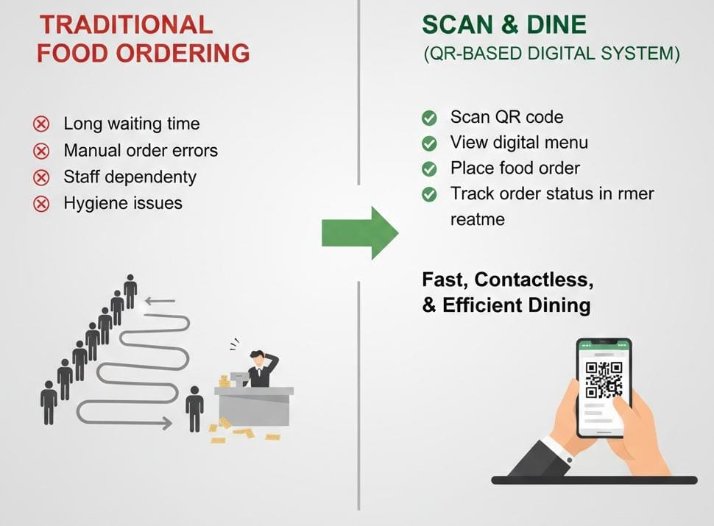
Introduction
Traditional food ordering systems cause:
Long waiting time
Manual order errors
Staff dependency
Hygiene issues
Scan & Dine is a QR-based digital food ordering system that allows customers to:
Scan QR code
View digital menu
Place food order
Track order status in real time
This system provides a fast, contactless, and efficient dining experience.
Notes:
This slide, The speaker will talk about the content that we will be covering in this session as follows:
Introduction
Importance of UI/UX in industry
History and Definitions of UI and UX
Key Differences between UI/UX
Use Cases
Significance in Web Development
Use Cases
Visual Design Principles
Design process
Color theory and psychology
Typography and readability
Layout and Spacing
Responsive design basics
Usability and Accessibility
Usability Aspects
Web Content Accessibility Guidelines (WCAG)
Inclusive design practices
Consistency
User Experience
User-Centered Design
User research methods
Interactive Elements and Feedback
Mini Case Study
Discussing a popular UI/UX design
Hands-On
Introduction to Figma for UI/UX design

Slide 6

Objective
To develop a contactless food ordering system
To reduce customer waiting time
To eliminate physical menus
To improve hygiene and safety
To automate order management
To reduce staff workload
To enhance customer experience

Slide 7
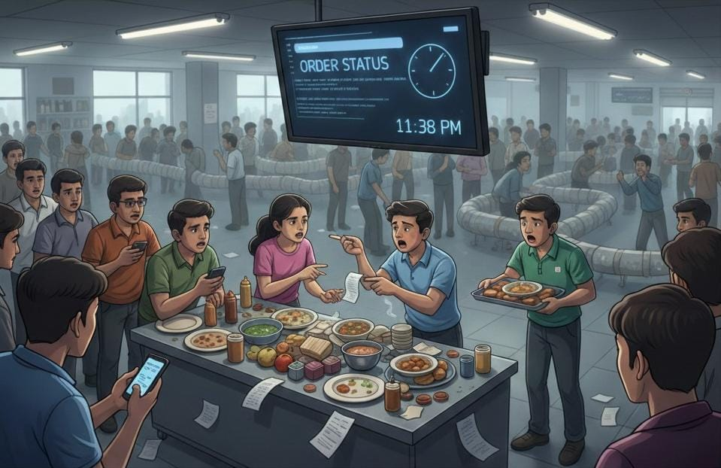
Problem Statement & Motivation
Problems :
Long queues in canteens
Delay in order taking
Order mismatch
No real-time order tracking
Manual handling increases errors
Motivation :
Post-COVID demand for contactless systems
Need for fast & digital solution
Improve efficiency and hygiene
Notes:
This slide, The speaker will talk about the content that we will be covering in this session as follows:
Introduction
Importance of UI/UX in industry
History and Definitions of UI and UX
Key Differences between UI/UX
Use Cases
Significance in Web Development
Use Cases
Visual Design Principles
Design process
Color theory and psychology
Typography and readability
Layout and Spacing
Responsive design basics
Usability and Accessibility
Usability Aspects
Web Content Accessibility Guidelines (WCAG)
Inclusive design practices
Consistency
User Experience
User-Centered Design
User research methods
Interactive Elements and Feedback
Mini Case Study
Discussing a popular UI/UX design
Hands-On
Introduction to Figma for UI/UX design

Slide 8
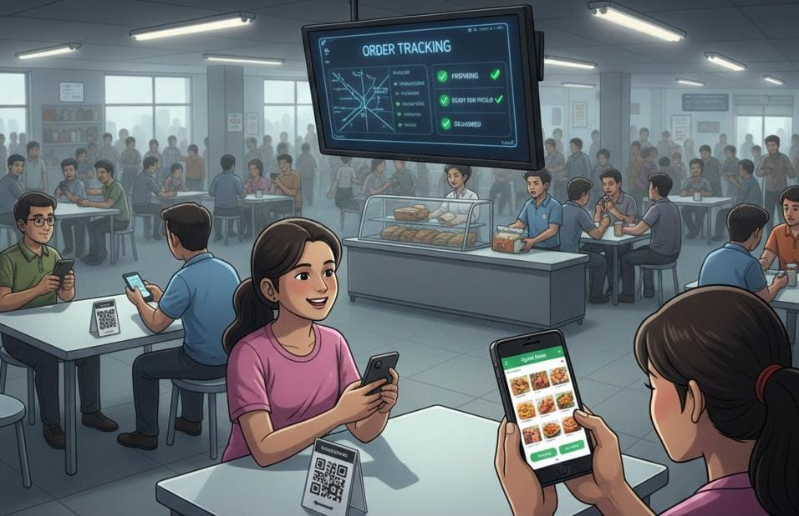
Solution Approach
QR code placed on each table
QR Code placed on each table
Customers scans QR using mobile
Digital menu opens in Browser
Items added to Cart
Order placed online
Backend Processes Order
Kitchen updates Order status
Customer Tracks order in real time
Notes:
This slide, The speaker will talk about the content that we will be covering in this session as follows:
Introduction
Importance of UI/UX in industry
History and Definitions of UI and UX
Key Differences between UI/UX
Use Cases
Significance in Web Development
Use Cases
Visual Design Principles
Design process
Color theory and psychology
Typography and readability
Layout and Spacing
Responsive design basics
Usability and Accessibility
Usability Aspects
Web Content Accessibility Guidelines (WCAG)
Inclusive design practices
Consistency
User Experience
User-Centered Design
User research methods
Interactive Elements and Feedback
Mini Case Study
Discussing a popular UI/UX design
Hands-On
Introduction to Figma for UI/UX design

Slide 9
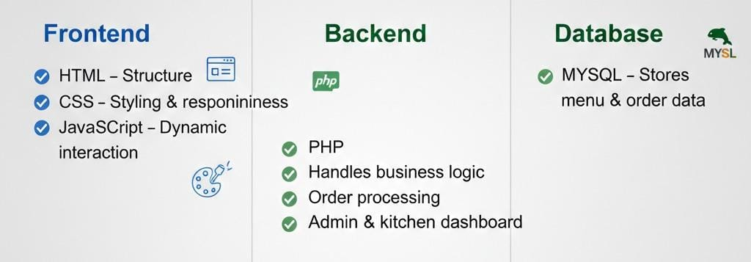
Technology Used
Frontend Technologies :
HTML5 – Structure of web pages
CSS3 – Styling and responsive design
JavaScript – Dynamic interaction and validation
Backend Technology :
PHP – Handles business logic
– Processes orders
– Manages admin & kitchen dashboard
– Communicates with database
Database
MySQL – Stores menu items
– Stores order details
– Stores order status
Other Tools
QR Code Generator
Web Hosting Server

Slide 10
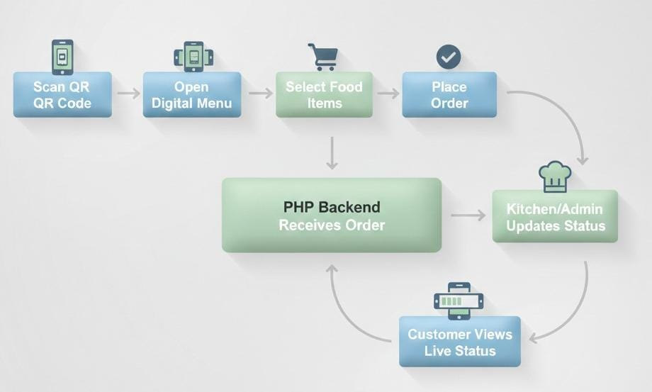
System Flowchart
Scan QR Code
Open Digital Menu
Select Food Items
Place Order
PHP Backend Receives Order
Order Stored In Database
Kitchen/Admin Updates Status
Customer Views Live Status

Slide 11
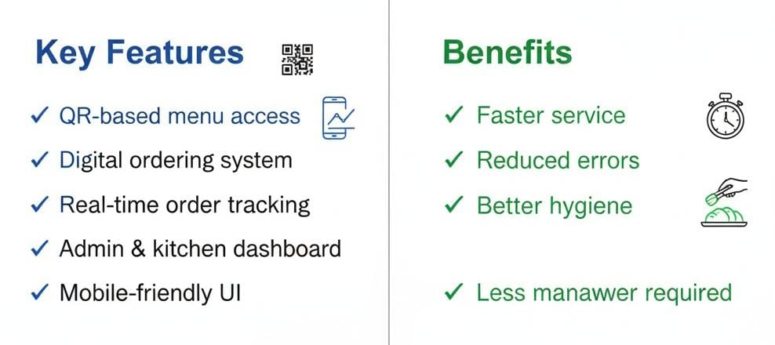
Key Features & Benefits
Key Features :
QR-based menu access
Digital ordering system
Real-time order tracking
Admin & kitchen dashboard
Mobile-friendly UI
Benefits :
Faster service
Reduced errors
Better hygiene
Less manpower required

Slide 12
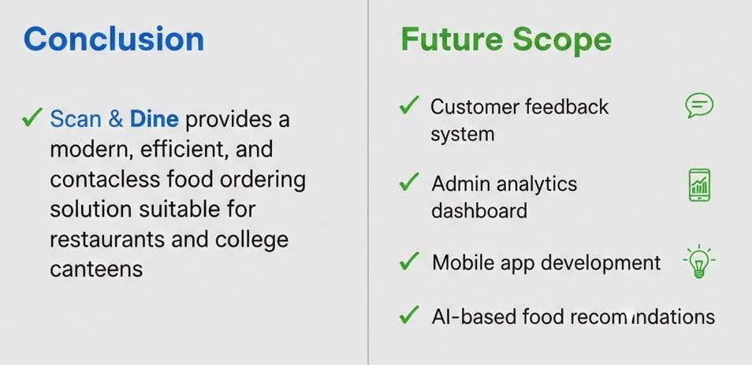
Conclusion and Future work
Conclusion :
Scan & Dine provides a modern, efficient, and contactless food ordering solution suitable for restaurants and college canteens.
Future Work :
Customer Feedback System
Admin analytics dashboard
Mobile app development
AI based food recommendation

Slide 13
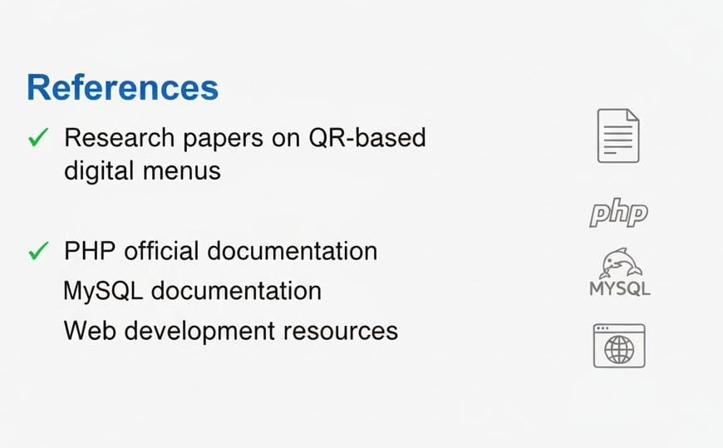
References
Research papers on QR-based digital menus
PHP official documentation
MySQL documentation
Web development resources
Notes:
This slide, The speaker will talk about the content that we will be covering in this session as follows:
Introduction
Importance of UI/UX in industry
History and Definitions of UI and UX
Key Differences between UI/UX
Use Cases
Significance in Web Development
Use Cases
Visual Design Principles
Design process
Color theory and psychology
Typography and readability
Layout and Spacing
Responsive design basics
Usability and Accessibility
Usability Aspects
Web Content Accessibility Guidelines (WCAG)
Inclusive design practices
Consistency
User Experience
User-Centered Design
User research methods
Interactive Elements and Feedback
Mini Case Study
Discussing a popular UI/UX design
Hands-On
Introduction to Figma for UI/UX design

